Slide 1
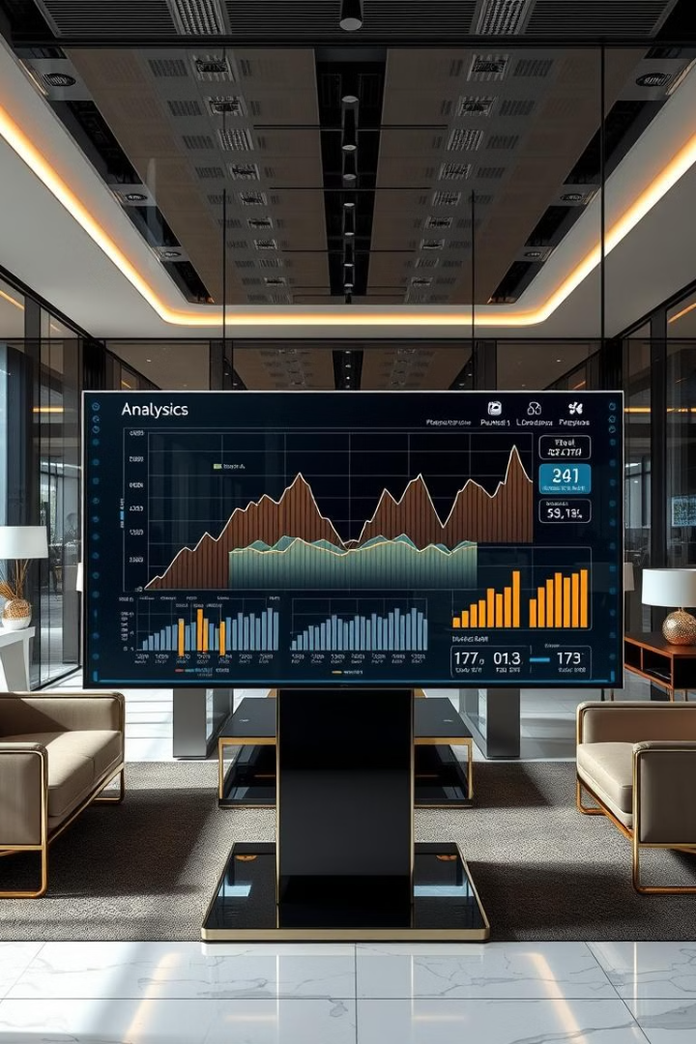
Credit Card Transaction & Customer Report
A data-driven analysis for business optimization, presented by [Your Name] on [Presentation Date]. This report dives deep into credit card transaction data to uncover valuable insights. These insights can drive revenue optimization, risk mitigation, and enhanced customer retention strategies.

Slide 2
Understanding Customer Behavior
Key Questions
Business Impact
How do different customer segments use credit cards?
Increase revenue while minimizing credit risk.
What are the key spending patterns?
Enhance business strategies.

Slide 3




Problem Statement: Revenue & Risk Optimization
Profitable Customers
Customer Retention
Identify the most profitable customer groups.
Improve retention through better offers.
Fraud Detection
Improve fraud detection models.

Slide 4
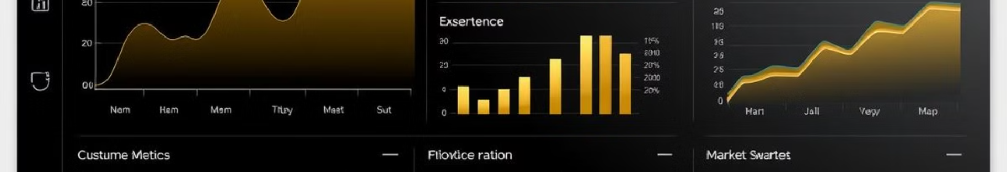



Solution Approach & KPIs
Data Collection
Customer Metrics
Spending Behavior
Categorizing customers based on job, income, age, and spending behavior to derive metrics such as total revenue, income group distribution and regional performance.

Slide 5
Optimization – Tools & Methods
Power BI / Tableau
1
Data visualization and trend identification
SQL & Python
2
Data extraction, transformation, and analysis
Machine Learning
3
Predict spending and detect anomalies
Using analytical tools such as SQL and Python, we will optimize the data to best predict customer spending behavior.

Slide 6
Insights from the Dashboard
Card Category
Customer Demographics
Transaction Methods
Regional Performance
Blue cardholders contribute the highest revenue.
High-income groups contribute the most revenue.
Swipe transactions dominate.
Texas, New York, and California lead in revenue generation.

Slide 7
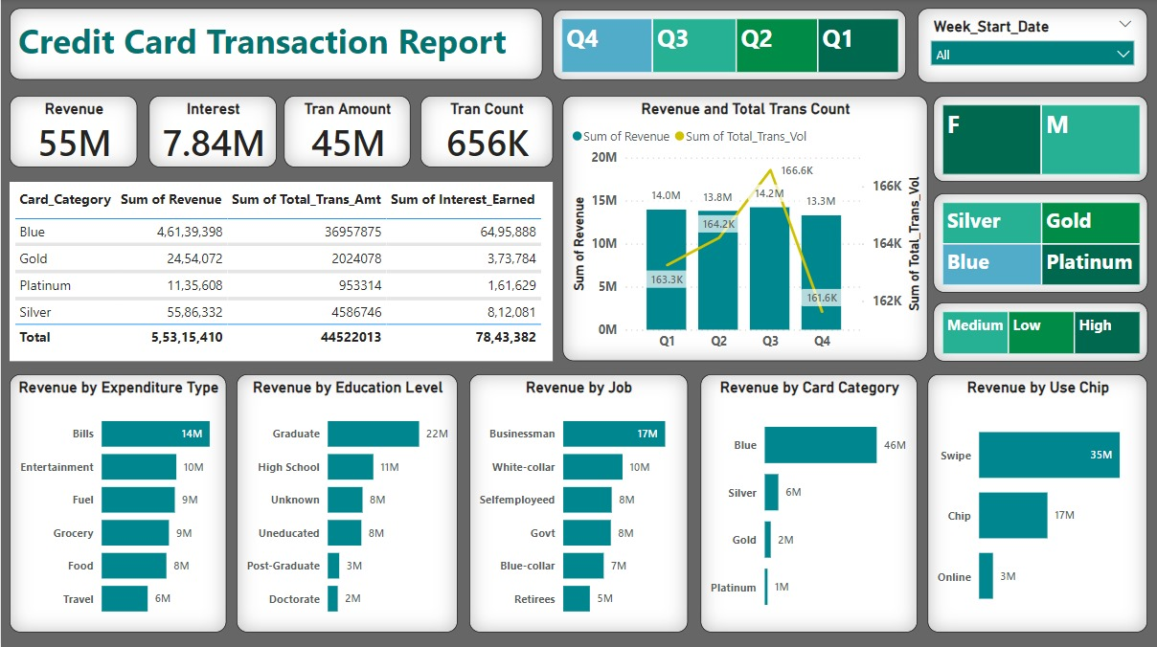
Dashboard

Slide 8
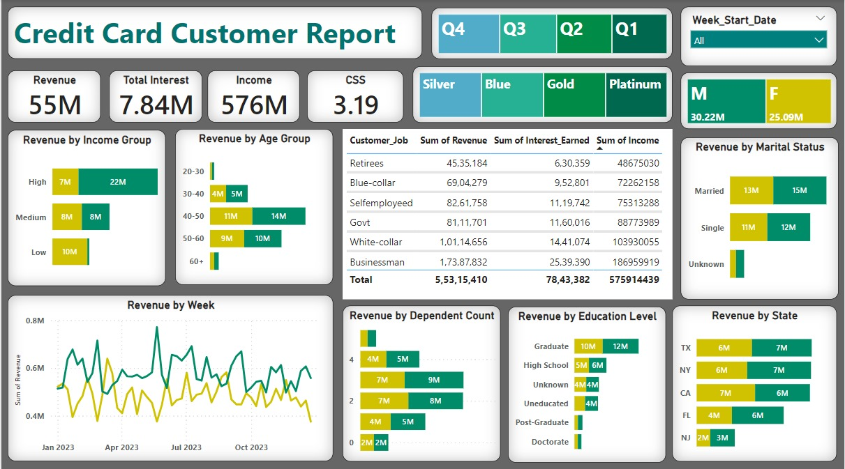
Dashboard

Slide 9




Data-Driven Business Strategies
Marketing
1
Retention
2
4
Expansion
3
Risk
This analysis helps implement targeted marketing, enhances customer retention, optimizes risk, and assists strategic business expansion by focusing on high-revenue regions and partnerships.

Slide 10

Conclusion & Next Steps
Key Insights
Optimization
Provides deep insights into customer spending behavior.
Optimizes revenue by targeting the right segments.
Focus
Focus on digital payment adoption & risk management.
Future scope includes advanced analytics & AI integration for better predictions and proactive decision-making.

